Slide 1
公司簡介

Slide 2
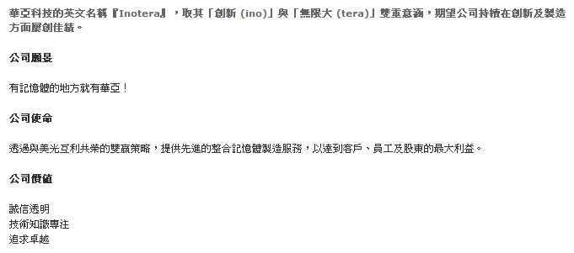
經營哲學

Slide 3
職務需求-軟體工程師
Job Description 工作職掌
Job Description 工作項目及內容 |  | Key performance index 績效衡量指標
Collect and Analyze the requirements from users | 10% | Communication skill
To design and develop big data project with Hadoop framework | 35% | Integrity of domain know- how
Write codes to implement the requirements | 30% | Coding Quality
Finish UT/IT and cross-test before release | 10% | Testing Quality
Co-work with system team to release program and verification | 5% | Release Quality
Take turns to be the on-call handler after probation | 10% | Excursion Handling Ability

Slide 4
職務需求-軟體工程師
Skills Requirement 職務能力需求
Description 敍述
Educational background學歷：Bachelor above, majored in Information Management or Information Engineering
Working experience工作經驗：Field領域- Software develop
Certification專業證照：NA
Others其他：
A. Proven experience in Hadoop development (Hive, Hbase, MapReduce), at least 2 years’ experience with Hadoop is preferable
B. Good understanding and/or experience with serialization frameworks such as Thrift, Avro and Google Protocol Buffers preferred.
C. Familiar with Java development, JVM performance turning.
D. Good command of spoken and written English, team work, good communication skill, and active attitude

