Slide 1
Windows Fileless Threats _{[Microsoft]}

Slide 2
Categorization
There are three main types of fileless threats based on how much fingerprint they may leave on infected machines.

Slide 3
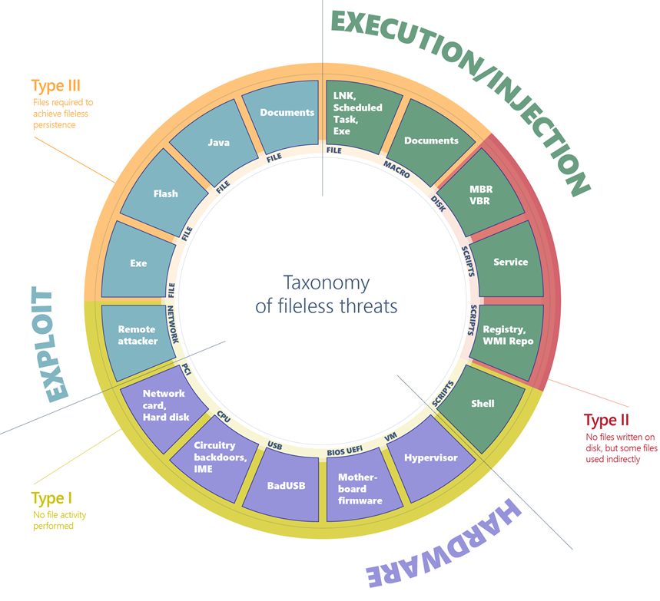
Comprehensive Diagram of Fileless Malware

Slide 4
Type I: No File Activity Performed
A fully fileless malware can be considered one that never requires writing a file on the disk.
How would such malware infect a machine in the first place?
One example is where a target machine receives malicious network packets that exploit the EternalBlue vulnerability.
The vulnerability allows the installation of the DoublePulsar backdoor, which ends up residing only in the kernel memory.
In this case, there's no file or any data written on a file.

Slide 5
Compromised Device and Firmware
A compromised device may also have malicious code hiding in device firmware (such as a BIOS), a USB peripheral (like the BadUSB attack), or in the firmware of a network card.
All these examples don't require a file on the disk to run, and can theoretically live only in memory. The malicious code would survive reboots, disk reformats, and OS reinstalls.

Slide 6
Type II: Indirect File Activity
Fileless malware of this type doesn't directly write files on the file system, but they can end up using files indirectly.
For example, with the Poshspy backdoor _{[alexia salone]} attackers installed a malicious PowerShell command within the WMI repository and configured a WMI filter to run the command periodically.

Slide 7
Type III: Files Required to Operate
Some malware can have a sort of fileless persistence, but not without using files to operate.
An example for this scenario is Kovter, which creates a shell open verb handler in the registry for a random file extension.
Opening a file with such extension will lead to the execution of a script through the legitimate tool mshta.exe.

Slide 8
Kovter's registry key
mshta
ActiveXObject
Wscript.shell
RegRead
n06
bEpL0

Slide 9
Windows 注册表常用操作 _{[mb611f699425272]}
1 添加一個主鍵(比如在HKEY_LOCAL_MACHINE\SOFTWARE\中添加一個ABCEDFGHIJKLMN主鍵)
Windows Registry Editor Version 5.00
[HKEY_LOCAL_MACHINE\SOFTWARE\ABCEDFGHIJKLMN]

Slide 10
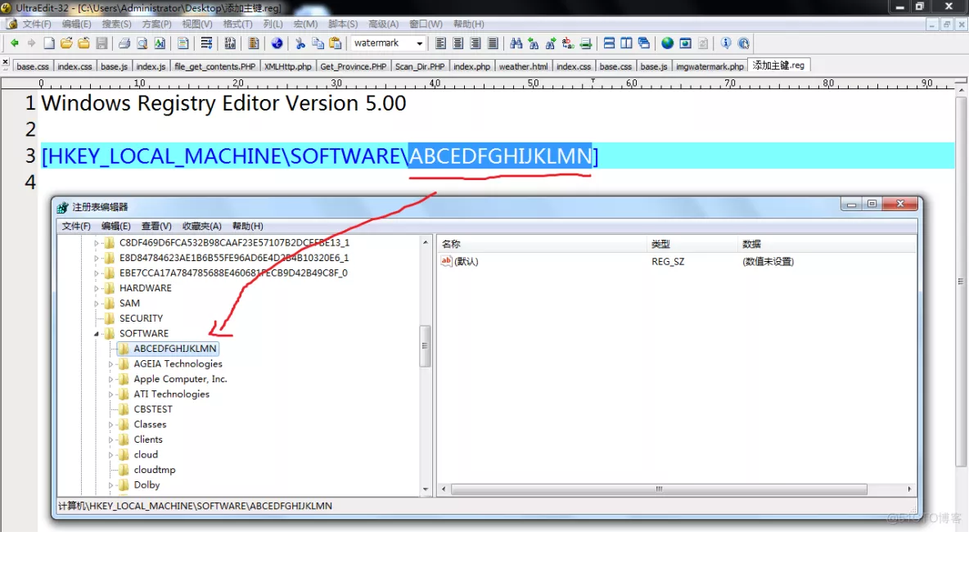
Windows 注册表常用操作範例 _{[mb611f699425272]}

Slide 11
添加鍵值_{[mb611f699425272]}
例如我們要在“HKEY_LOCAL_MACHINE\Software\ ABCEDFGHIJKLMN”主鍵下设置預設鍵值為“工作室”，並分别添加“姓名”鍵值項目(字符串值)、“年龄”鍵值項目(二進制值)、“婚否”鍵值項目(DWORD值)。相應的REG文件内容如下：
Windows Registry Editor Version 5.00
[HKEY_LOCAL_MACHINE\SOFTWARE\ABCEDFGHIJKLMN]
@="工作室"
"姓名"="陶海"
"年龄"=hex:23
"婚否"=dword:00000000

Slide 12
添加鍵值範例_{[mb611f699425272]}

Slide 13
How to Create Registry Script (.REG) Files in Windows_{[VG]}

Slide 14
mshta命令用法示例 _{[mdxy-dxy]}
mshta支持命令行參數，可以接收JS和VBS的方法。
範例（在命令行下測試）：
JS:
mshta vbscript:window.execScript("alert('hello world!');","javascript")
VBS:
mshta javascript:window.execScript("msgBox('hello world!'):window.close","vbs")

Slide 15
mshta多個命令 _{[mdxy-dxy]}
串接多個命令時，js 用分號 ;。
mshta "javascript:alert('OK！');alert('1234');window.close()"
串接多個命令時，vbs 用&。
mshta "vbscript:msgbox("内容") & msgbox("1234") & window.close"
※注意&在bat中有特殊意義，所以此時mshta後面的程式碼必需用引號！

Slide 16
ActiveXObject _{[程式前沿]}

Slide 17
Explanation
When the open verb is invoked, the associated command from the registry is launched, which results in the execution of a small script.
This script reads data from a further registry key and executes it, in turn leading to the loading of the final payload.
However, to trigger the open verb in the first place, Kovter has to drop a file with the same extension targeted by the verb (in the example above, the extension is .bbf5590fd).
It also has to set an autorun key configured to open such file when the machine starts.

Slide 18
Execution and Injection of File-Based Fileless Malware
File-based (Type III: executables, DLLs, LNK files, scheduled tasks):
This is the standard execution vector.
A simple executable can be launched as a first-stage malware to run an additional payload in memory, or injected into other legitimate running processes.

Slide 19
Execution and Injection of Macro-Based Fileless Malware (1)
Macro-based (Type III: Office documents):
The VBA language is a flexible and powerful tool designed to automate editing tasks and add dynamic functionality to documents.
As such, it can be abused by attackers to carry out malicious operations like decoding, running, or injecting an executable payload, or even implementing an entire ransomware, like in the case of qkG.

Slide 20
Execution and Injection of Macro-Based Fileless Malware (2)
Macros are executed within the context of an Office process (e.g., Winword.exe) and implemented in a scripting language.
There's no binary executable that an antivirus can inspect.
While Office apps require explicit consent from the user to execute macros from a document, attackers use social engineering techniques to trick users into allowing macros to execute.

Slide 21
Execution and Injection of Script-Based Fileless Malware (1)
Script-based (Type II: file, service, registry, WMI repo, shell):
The JavaScript, VBScript, and PowerShell scripting languages are available by default on Windows platforms.
Scripts have the same advantages as macros, they are textual files (not binary executables) and run within the context of the interpreter (like wscript.exe, powershell.exe), which is a clean and legitimate component.

Slide 22
Execution and Injection of Script-Based Fileless Malware (2)
Scripts are versatile and can be run from a file (by double-clicking them) or executed directly on the command line of an interpreter.
Running on the command line allows malware to encode malicious scripts as autostart services inside autorun registry keys as WMI event subscriptions from the WMI repo.
Furthermore, an attacker who has gained access to an infected machine may input the script on the command prompt.

Slide 23
Supplementary Materials

Slide 24
What is fileless malware and how does it work? _{[Alison Grace]}
A new secret stash for “fileless” malware _{[DENIS LEGEZO]}

Slide 25
certutil.exe _{[Microsoft]}
certutil.exe is a command-line program, installed as part of Certificate Services.
You can use certutil.exe to dump and display certification authority (CA) configuration information, configure Certificate Services, backup and restore CA components, and verify certificates, key pairs, and certificate chains.

Slide 26
mshta.exe _{[file.net]}
The genuine mshta.exe file is a software component of Windows Internet Explorer by Microsoft Corporation.
The genuine "mshta.exe" file, if located in "C:\Windows\System32", is the Microsoft HTML Application Host program, a component of the Microsoft Windows operating system since 1999.

Slide 27
mshta.exe _{[file.net]}
HTML Application (.hta) files contain source code combining HTML, Dynamic HTML, and one or more scripting languages such as VBScript or Jscript.
Executing these HTA files in "mshta.exe", which shares much of its code with Internet Explorer, produces apps that look like web pages but can access local resources, (e.g., the local computer's file system).
Although "mshta.exe" is not malware it is often used by malware to execute rogue HTA code and store unwanted payloads.

Slide 28
Windows Shell _{[Microsoft]}
The Windows UI provides users with access to a wide variety of objects necessary for running applications and managing the operating system.
The most numerous and familiar of these objects are the folders and files that reside on computer disk drives.
There are also a number of virtual objects that allow the user to perform tasks such as sending files to remote printers or accessing the Recycle Bin.
The Shell organizes these objects into a hierarchical namespace and provides users and applications with a consistent and efficient way to access and manage objects.

